Slide 1


Triplet Variational Autoencoder with Semantic-Guided Features Retrieval for Enhanced Unsupervised Anomaly Detection in Brain MRI.
Student: Huang, Han-Sheng
Advisor: Chen, Yong-Sheng
National Yang Ming Chiao Tung University – Institute of Multimedia Engineering
2023.10.24

Slide 2


Outline
Introduction
Related Works
Materials and Methods
Experimental Results
Conclusions and Future Works

Slide 3

1
Introduction

Slide 4
Introduction
Introduction
Magnetic Resonance Imaging (MRI) is widely used in the medical field for various purposes, including early diagnosis, accurate disease staging, and treatment planning.
The analysis and interpretation of MR scans present a complex challenge. Studies suggest that in 5-10% of cases, significant pathologies go unnoticed [1] [2]. Therefore, the need for supportive tools to enhance the efficiency of radiological assessments becomes evident.
In addition, Magnetic Resonance Imaging (MRI), particularly T1-weighted and T2-weighted images, the appearance of brightness or darkness is not solely indicative of inflammation regions.
[1] Baur et al., “Autoencoders for unsupervised anomaly segmentation in brain mr images: A comparative study,” Medical image analysis, 2020
[2] Bruno et al., “Understanding and confronting our mistakes: The epidemiology of error in radiology and strategies for error reduction” RadioGraphics, 2015
Notes:
My research would revolves around the magnetic resonance imaging which is a cornerstone of modern medicine and is crucial for early diagnosis, precise disease staging, and tailoring effective treatment plans.
Navigating MR scans is no simple task as research by Bruno et al shows that 5-10% of cases might miss significant pathologies. Hence, this calls for a tool to improve
efficiency of radiological assessments, focusing expert effort directly on areas of concern.
Additionally, CSF or Cerebrospinal fluid occupies the same intensity as inflammation regions, namely lower intensity on T1 imaging and higher intensity on T2 imaging

Slide 5
Introduction
Introduction
Supervised machine learning techniques have demonstrated remarkable achievements across diverse applications, notably in the domain of lesion detection on MRI, even a method from 4 years ago (OM-Net + CGAp) [3] already achieved 90% DICE score on brain tumor segmentation task.
While unsupervised approaches, to this date, are yet to surpass their performance. Thus it’s complexity offer room for further improvements and innovations.
[3] Zhou et al., “Onepass multitask networks with crosstask guided attention for brain tumor segmentation,” IEEE Transactions on Image Processing, 2019.
Notes:
In medical anomaly detection, supervised machine learning has yielded impressive results. even a method proposed 4 years ago just to name one OM-Net combined with CGAp achieved a remarkable 90% DICE score in brain tumor segmentation. However the unsupervised methods have yet to catch up, leaving room for further advancements and innovations in this domain.

Slide 6
Introduction
Introduction
Unsupervised learning plays a crucial role in anomaly detection:
Limited availability of labelled data.
Limited time and resources of medical experts for manual annotation.
In theory, the adaptive capacity of learning solely from normal data extends to diverse, previously unseen lesions.
Useful for pre-screening and improving radiological assessment efficiency.
Notes:
Despite the outstanding performance of the supervised learning method, in real life scenario often the availability of labelled data is costly
Unsupervised generalize better, while supervised are optimized during the training phase to detect lesions of pre-specified types based on examples in the training set. limits their applicability to unseen lesions.
Unsupervised requires only healthy data, anomalies can be detected as outliers from the modeled, normative distribution

Slide 7
2
Related Works

Slide 8
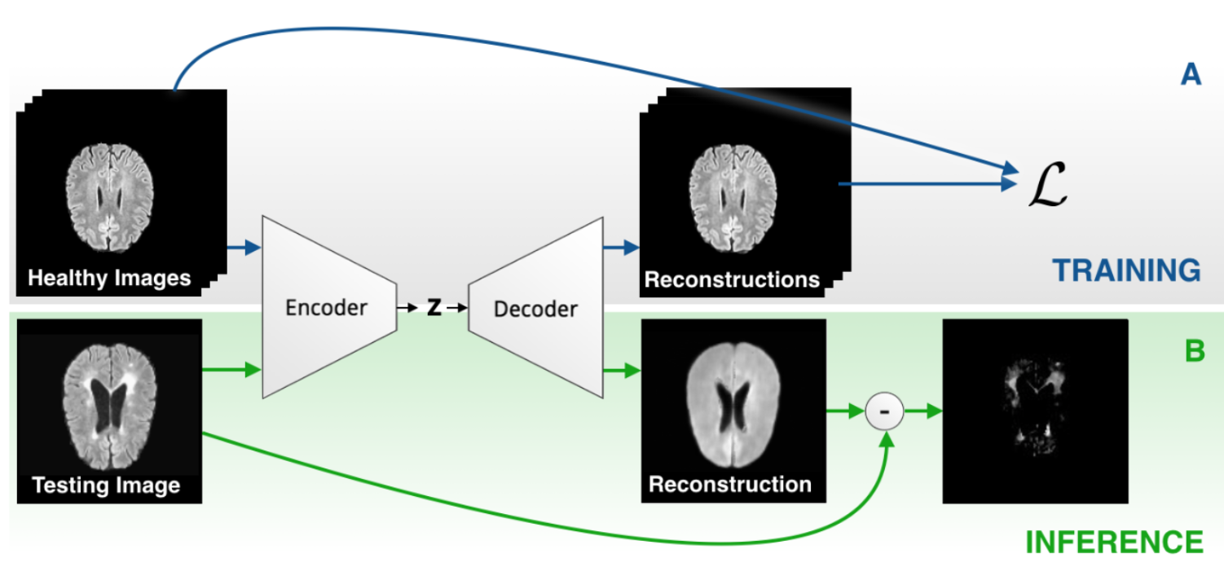
Related Works
Unsupervised Anomaly Detection with Autoencoder
The Unsupervised Anomaly Detection (UAD) approach for detecting brain lesions through the modeling of the healthy brain distribution [4].
Identified and outlined anomalies as deviations from the norm by assessing the reconstruction error at a pixel level.
[4] Baur et al., “Deep autoencoding models for unsupervised anomaly segmentation in brain mr images,” in BrainLes@MICCAI, 2018
Notes:
The basic formulation for the unsupervised brain anomaly detection (UAD) task is based on representation learning requiring only a set of normal data. The detection and delineation of pathologies are thereby obtained from a pixel-wise reconstruction error.
Given the constrained anatomical variability of the healthy brain, an alternative approach is to model the distribution of healthy brains, and both detect and delineate pathologies as deviations from the norm.

Slide 9
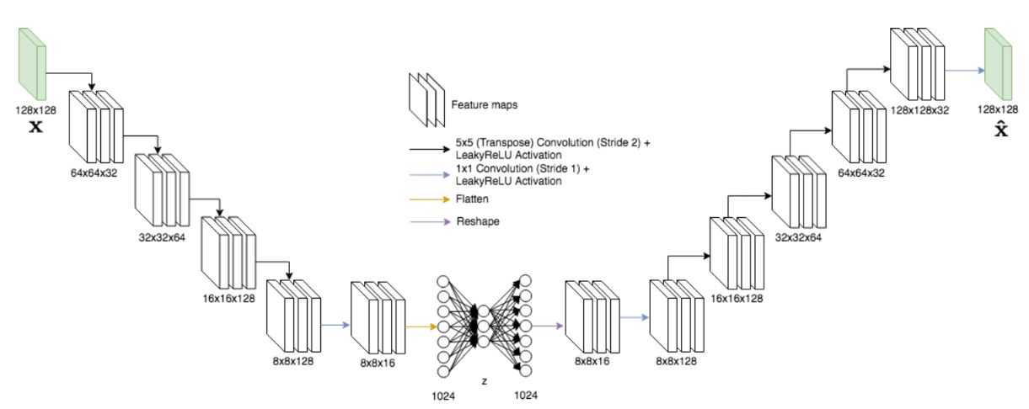
Related Works
Best Methods for Anomaly Detection in Brain MRI (Baur et al., 2020) [5]
Evaluated various contemporary approaches using a uniform architecture, resolution, and datasets.
Examined models across diverse domains, encompassing autoencoders, Latent Variable Models, and Generative Adversarial Network variations, both spatial and dense in bottleneck design.
Restoration VAE and F-AnoGAN showed exceptional performance, with VAE proving to be the most easily optimized.
[5] Baur et al., “Autoencoders for unsupervised anomaly segmentation in brain mr images: A comparative study,” Medical image analysis, 2020
Notes:
stablish comparability among recent methods by utilizing a single architecture, a single resolution and the same dataset(s)
Compared 17 models including autoencoders, Latent Variable Models, and Generative Adversarial Network variations with both spatial and dense bottleneck design.
Restoration VAE and F-AnoGAN are among the best.
The blurry reconstruction of latent variable models allows to discriminate better between anomalies and normal tissues, VAE to be the recommended choice, as it not only performs the best, but is the easiest to optimize.

Slide 10
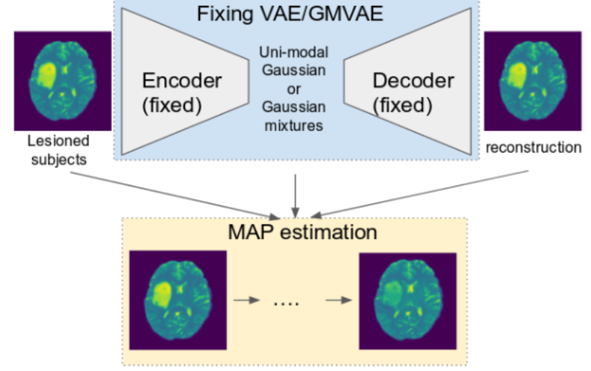
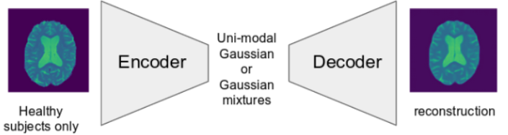
Related Works
Restoration-VAE (You et al., 2018) [6]
Redefined detection as a Maximum-A-Posteriori (MAP) image restoration problem due to the misconception identified in prior projection method.
Prior projection method implied a significant similarity in latent space representations between lesion and lesion-free images.
Applies a gradient ascent technique and conducts iterative optimization to achieve the restored image.
[6] You et al., “Unsupervised lesion detection via image restoration with a normative prior,” Medical image analysis, 2018
Notes:
In the earlier prior projection method, they neglected the latent projection gap between the lesion and lesion-free image,
Suggesting they would both produce a similar projections.
also uses DL-based non-linear latent variable models to approximate the normative distri- bution of healthy anatomy from example images. However, instead of using prior projection, casts the unsupervised detection problem as a Maximum-A-Posteriori (MAP) image restoration problem with the normative image prior estimated by a DL- based model
adopt a gradient ascent method and perform iterative optimization to obtain the restored image. (ascent because we are modifying input in respect to larger error)
Notes:
Maximum a Posteriori (MAP) is a statistical concept used in the field of probability and statistics. It's a method for estimating the most probable value of an unknown quantity based on observed data and prior knowledge about that quantity.

Slide 11
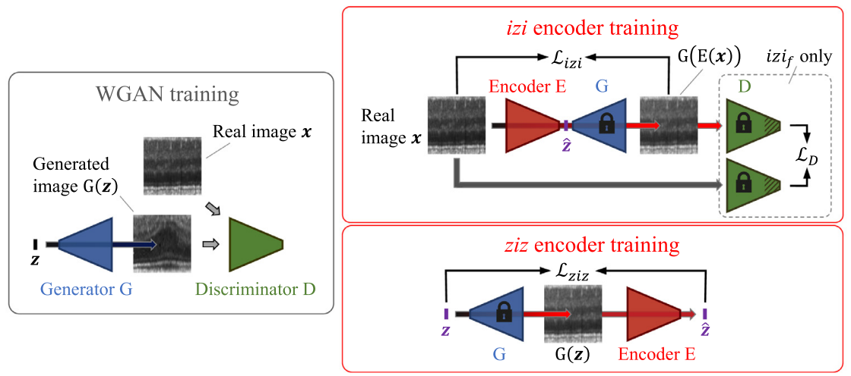
Related Works
f-AnoGAN (Schlegl et al., 2019) [7]
Proposed to learn normal anatomical variability with a generative adversarial network.
Reuses generator and discriminator from the GAN to evaluate a fast mapping technique of new data to the GAN’s latent space.
Disadvantage: suboptimal fast mapping might produce an entirely different brain structure for healthy region resulting in undesired residuals.
[7] Schlegl et al, “f anogan: Fast unsupervised anomaly detection with generative adversarial networks,” Medical Image Analysis, 2019
Notes:
Train a generative model of healthy training data, and propose and evaluate a fast mapping technique of new data to the GAN’s latent space with a new encoder on the 2nd step.
In the better performing approach of encoder training izif, it simultaneously guides encoder training in the image space and in the latent space.
During the model evaluation we found a suboptimal latent mapping of image with lesion might produce an entirely different brain structure resulting in undesired residuals from the substraction

Slide 12
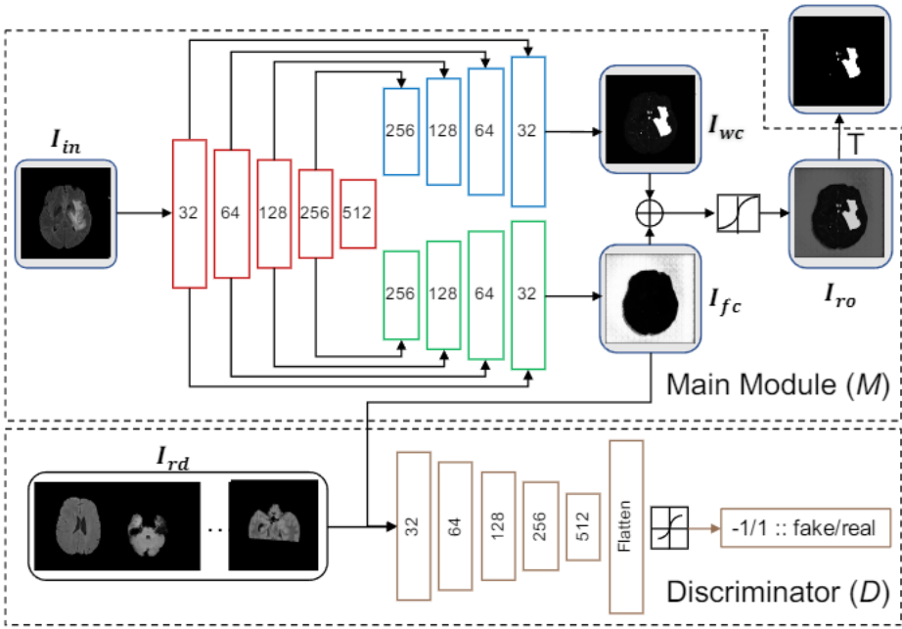
Related Works
ASC-Net (Dey, Raunak and Yi Hong, 2021) [8]
Presented an adversarial framework for UAD, eliminating the need for traditional image reconstruction by directly focusing on anomaly detection.
Employs a decomposition approach, partitioning the image into two segments based on reference image distribution. (in and outside the distribution)
Leverages the discriminator to incorporate knowledge derived from the reference image distribution.
[8] R. Dey and Y. Hong, “Ascnet: Adversarialbased selective network for unsupervised anomaly segmentation,” in Medical Image Computing and Computer Assisted Intervention – MICCAI 2021
Notes:
Proposing an adversarial based framework for unsupervised anomaly segmentation, which bypasses the normal image reconstruction and works on anomaly detection directly.
Decompose the image into two cuts based on the reference image distribution
One cut will fall into the reference distribution
The other cut is outside of the reference image distribution
Discriminator helps to introduce the knowledge from the reference image distribution

Slide 13
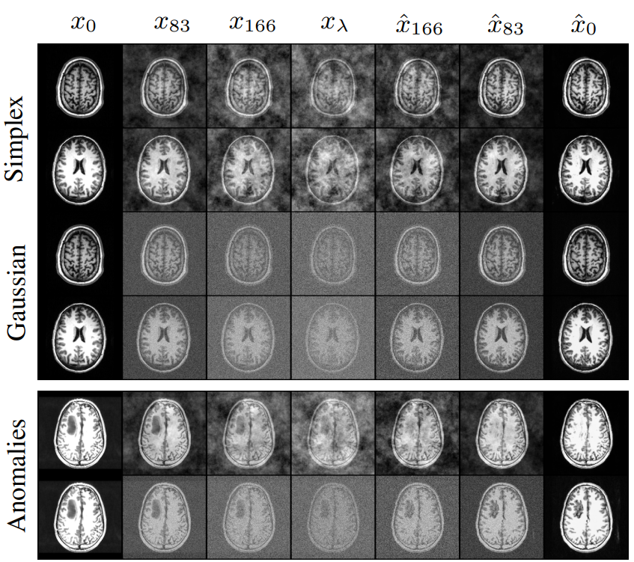
Related Works
AnoDDPM with Simplex Noise (Wyatt et al., 2022) [9]
Presented the utilization of denoising diffusion probabilistic models alongside an innovative partial diffusion anomaly detection technique.
Leverages multi-scale (multi-octave) simplex noise to enable larger anomalous regions to be reconstructed as healthy areas due to its generation of coherent or structured randomness, in contrast to conventional white noise.
[9] Wyatt et al., “Anoddpm: Anomaly detection with denoising diffusion probabilistic models using simplex noise,” 2022 IEEE/CVF Conference on Computer Vision and Pattern Recognition Workshops (CVPRW)
Notes:
Introduce the application of denoising diffusion probabilistic models with a partial diffusion strategy for unsupervised anomaly detection.
query image x0 is corrupted for t timesteps xt which is then denoised back to xˆ0.
Proposed the use of multi-scale (multi-octave) simplex noise instead of the classical white noise to allow larger anomalous regions to become reconstructed as healthy regions.
Due to the fact, simplex noise produce smooth or structured randomness

Slide 14
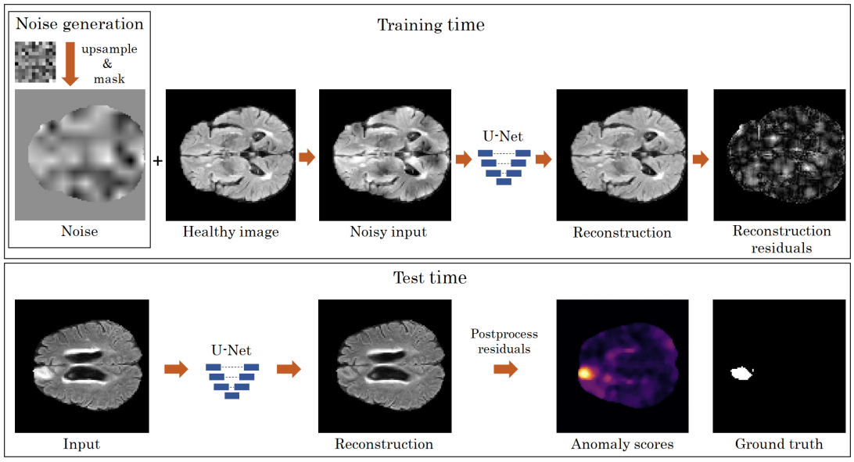
Related Works
DAE (Kascenas et al., 2022) [10]
Demonstrated the effectiveness of DAE with coarse noise compared to traditional pixel/voxel-level noise in UAD task.
Incorporated noise into the healthy image foreground, enabling the network to learn noise removal and image reconstruction.
[10] Kascenas et al., “Denoising autoencoders for unsupervised anomaly detection in brain mri,” in International Conference on Medical Imaging with Deep Learning, 2022
Notes:
Proposed a DAE as a baseline for unsupervised anomaly detection
Shown DAE with coarse noise is better than with traditional pixel/ voxel-level noise
During training (top), noise is added to the foreground of the healthy image, and the network is trained to remove the noise and reconstruct the original image. At test time (bottom), the pixelwise postprocessed reconstruction error is used as the anomaly score.

Slide 15
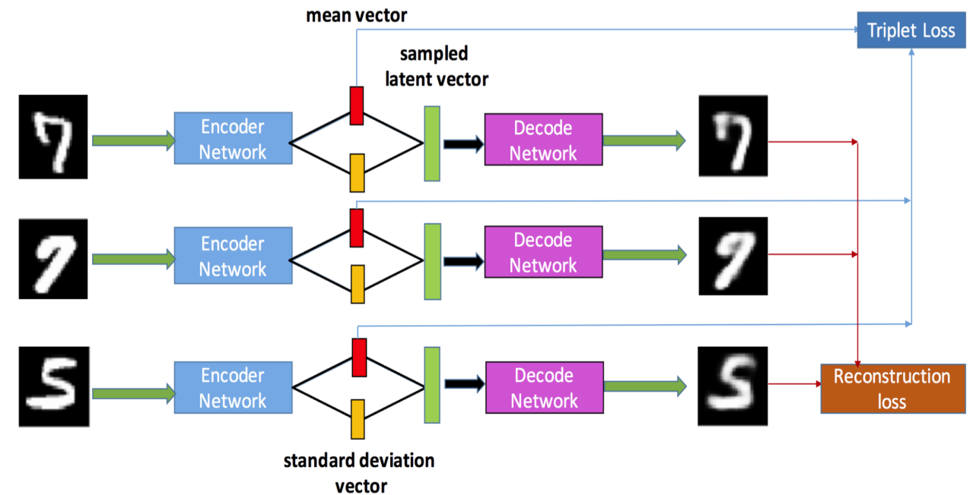
Related Works
Incorporating Deep Metric Learning on VAE (Haque et al., 2018) [11]
Demonstrated the efficacy of the Triplet-based Variational Autoencoder (TVAE) in capturing intricate details within the latent embedding.
Network is trained to minimize the upper-bound on the expected negative log-likelihood of data and triplet loss on the mean vectors of VAE simultaneously.
[11] Haque et al., “Tvae: Tripletbased variational autoencoder using metric learning,” ArXiv, vol. abs/1802.04403, 2018
Notes:
Triplet based Variational Autoencoder (TVAE), allows us to capture more fine-grained information in the latent embedding.
Paraphrased (Our approach aims to restore input images to healthy states for both healthy and anomalous inputs, disentangling triplet learning from latent space projection for consistent representations.) will be further explained in the method section
Notes:
Negative Log-Likelihood: This measures how well a model's predictions align with the actual data. In the case of a VAE, it's used to measure how well the generated data (through the decoder) matches the real data. The negative log-likelihood quantifies the dissimilarity between the generated data and the actual data. Lower values indicate a better match.
Expected Negative Log-Likelihood: This is the average or expected value of the negative log-likelihood over all the data points in a dataset. It provides an overall assessment of how well the model is performing on average.
Upper-Bound: In VAE, the objective is not to directly optimize the true expected negative log-likelihood because it's often intractable to compute. Instead, the model aims to find an upper-bound on this value that can be optimized efficiently.

Slide 16
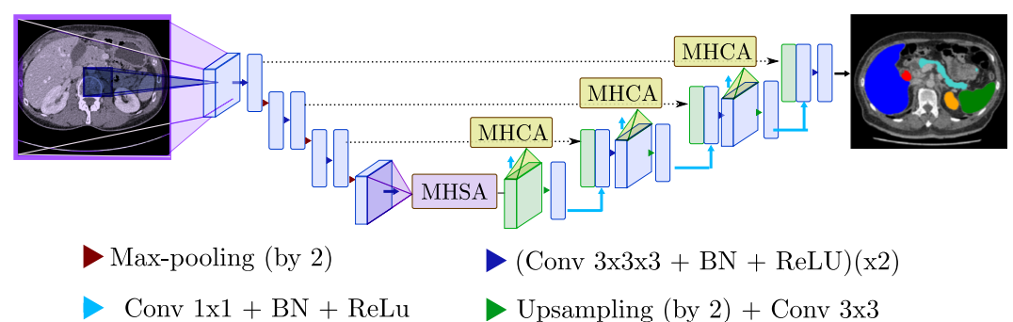
Related Works
Attention Module for Medical Image Segmentation (Haque et al., 2018) [12]
Integrated a U-shaped architecture for image segmentation with self- and cross-attention mechanisms from Transformers.
The self-attention module facilitates comprehensive interactions among encoder features.
The cross attention in skip connections enhances spatial precision in the U-Net decoder by discerning and excluding non-semantic features.
[12] Petit et al. U net transformer: Self and cross attention for medical image segmentation,” in Machine Learning in Medical Imaging: 12th International Workshop, MLMI 2021
Notes:
Introduce U-Transformer network, combining a U-shaped
architecture for image segmentation with not only self- but also cross-attention from
Transformers.
To allows a fine spatial recovery in the U-Net decoder by filtering out non-semantic features.
Aligned with the concept of the U-Net Transformer, we incorporated cross attention mechanisms to eliminate non-semantic attributes within the skip connection features, emphasizing areas of substantial relevance for the task. However, divergent from the U-Net approach, our focus lies in diminishing the spatial intensity of non-semantic low-level features, rather than altering the regional structure itself.
Paraphrased (We integrated cross attention to remove non-semantic features from skip connections, aiming to reduce spatial intensity of low-level non-semantic attributes, distinct from U-Net's emphasis on structural alteration.)

Slide 17
Related Works
Contributions
Implemented a novel unsupervised training scheme with metric learning that surpasses the performance of the previous anomaly detection methods.
We rectify a misconception in previous projection-based methods, which assumed that healthy regions would remain unchanged in the reconstructed output. This implied a significant similarity in latent space representations between lesion and lesion-free images.
Proposed a novel semantic-guided gated cross skip connection module to enhance the retrieval of low-level non-semantic information.
Explore the benefits of incorporating the structural similarity index as an supplementary training loss function.
Notes:
Should we add this, this might be irrelevant, as the purpose and design are different
further incorporate the structure informa-
tion, we introduce a structure embedding scheme which ex-
plicitly feeding the learned structure features into the in-
painting process serving as preconditions for image com-
pletion.

Slide 18
3
Materials and Methods

Slide 19
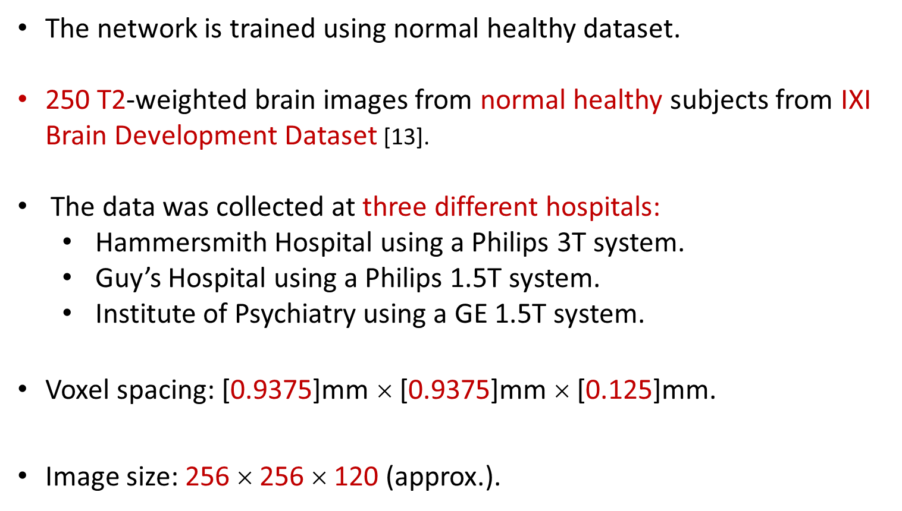
Materials and Methods
Healthy Dataset
The network is trained using normal healthy dataset.
250 T2-weighted brain images from normal healthy subjects from IXI Brain Development Dataset [13].
The data was collected at three different hospitals:
Hammersmith Hospital using a Philips 3T system.
Guy’s Hospital using a Philips 1.5T system.
Institute of Psychiatry using a GE 1.5T system.
Voxel spacing: [0.9375]mm $$ [0.9375]mm $$ [0.125]mm.
Image size: 256 $$ 256 $$ 120 (approx.).

Slide 20
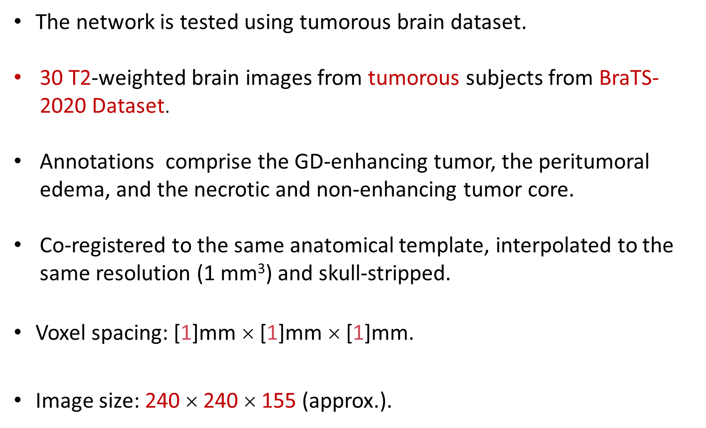
Materials and Methods
Anomalous Dataset
The network is tested using tumorous brain dataset.
30 T2-weighted brain images from tumorous subjects from BraTS-2020 Dataset.
Annotations comprise the GD-enhancing tumor, the peritumoral edema, and the necrotic and non-enhancing tumor core.
Co-registered to the same anatomical template, interpolated to the same resolution (1 mm³) and skull-stripped.
Voxel spacing: [1]mm $$ [1]mm $$ [1]mm.
Image size: 240 $$ 240 $$ 155 (approx.).
Notes:
"GD-enhancing tumor (ET — label 4)" refers to tumor tissue that enhances with a contrast agent in images acquired through Gadolinium-enhanced MRI scans. "Peritumoral edema (ED — label 2)" refers to the region of tissue surrounding the tumor that exhibits swelling or edema. "Necrotic and non-enhancing tumor core (NCR/NET — label 1)" refers to the central portion of the tumor that does not enhance with the contrast agent and may show signs of necrosis or tissue death.
The contrast agent referred to in the previous explanation is a substance that is injected into the body before a medical imaging procedure,
Edema refers to the accumulation of excess fluid in the body's tissues, leading to swelling and increased tissue volume.
Add or not?
The data was acquired with different clinical protocols and various scanners from 19 institutions.

Slide 21
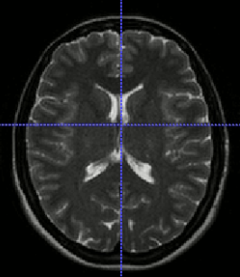
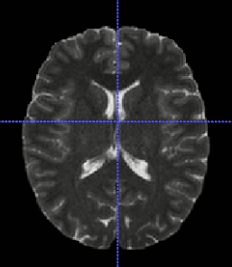
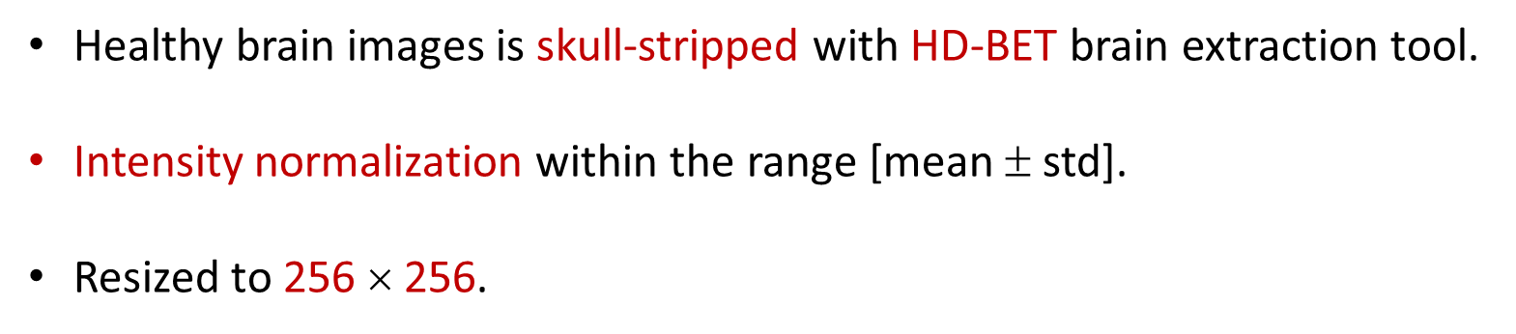
Materials and Methods
Dataset Preprocessing
Healthy brain images is skull-stripped with HD-BET brain extraction tool.
Intensity normalization within the range [mean ± std].
Resized to 256 $$ 256.
Original T2
Skull-stripped T2
Notes:
Pixel value from 0-600 to 0-0.6
0-0.6
0-0.6
Mean 33
Std 77.5

Slide 22
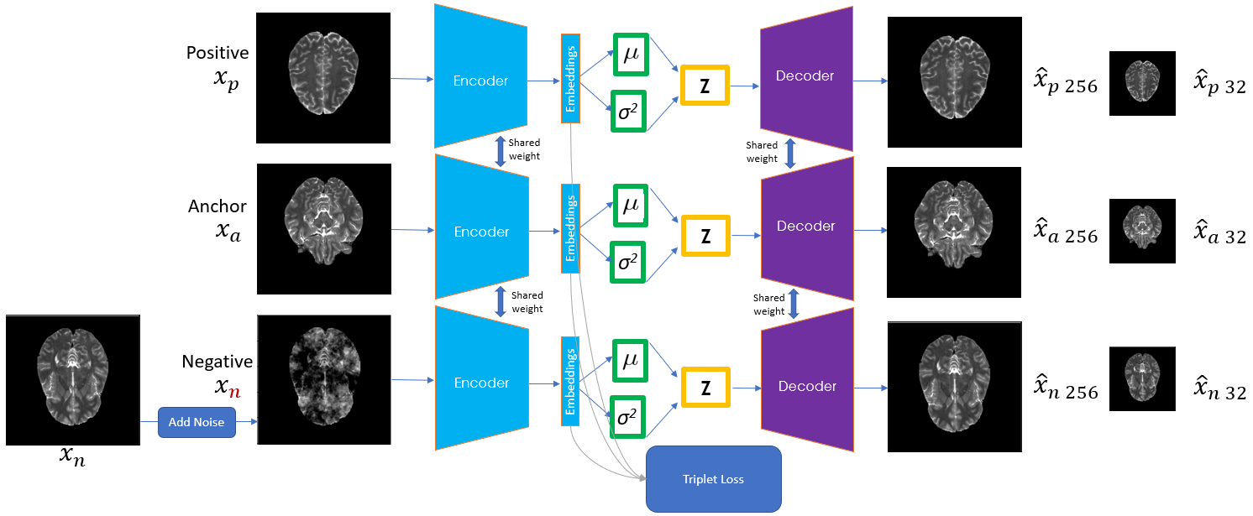
Materials and Methods
Anomaly Detection Method: Training Scheme
Notes:
Triplet net with shared weight
Metric learning
Only train on healthy 2d brain image dataset
NOISE in negative sample to mimic existence of anomaly
Triplet Variational Autoencoder (VAE) to simultaneously learn healthy brain data distribution and reconstruct the healthy version of input images. Utilizing a Variational Autoencoder (VAE) equipped with metric learning, we employ an approach to create and reconstruct a healthy rendition of the input image. This holds true whether the input is in its original healthy state or with added noise. This process is facilitated by mastering the underlying semantic features of both regular healthy images and their noisier counterparts. These learned features subsequently serve as the blueprint for anomaly detection, allowing us to distinguish deviations from the norm.
the network is encouraged to perform as it was explicitly trained: capturing the unique information of each brain slice, projecting its latent representation onto a normal version, and reconstructing its healthy brain counterpart

Slide 23
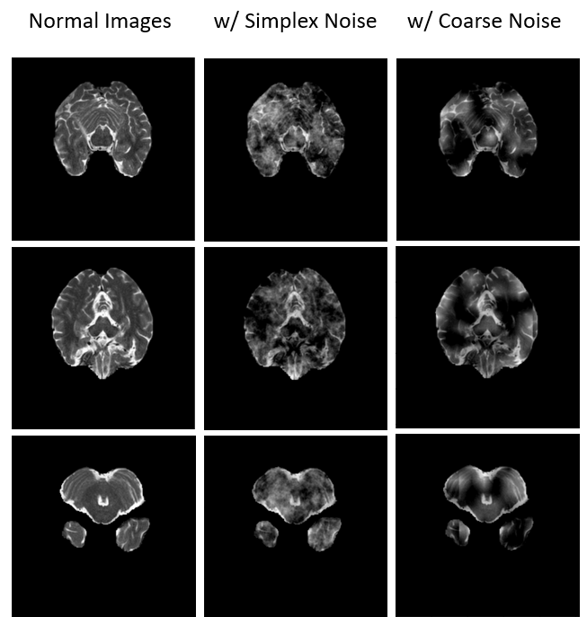
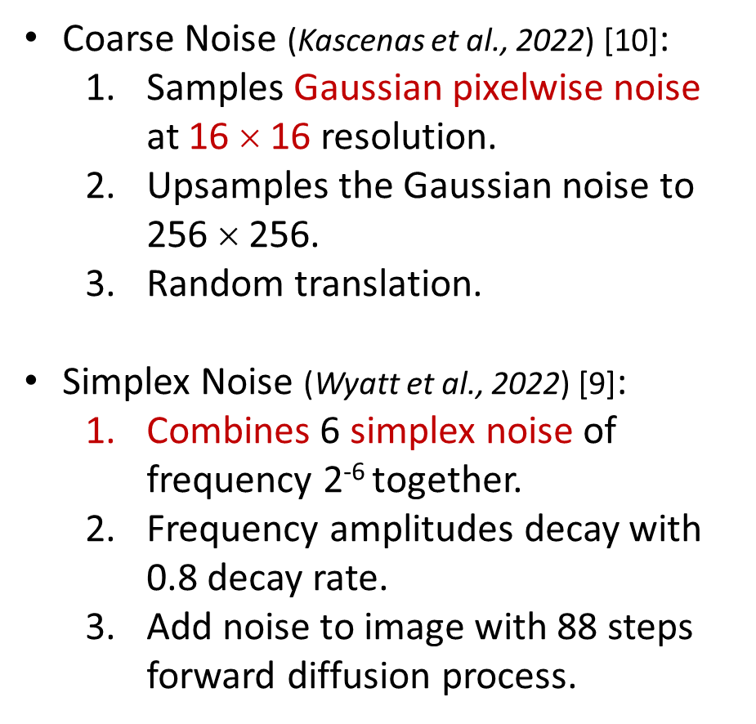
Materials and Methods
Noise(s) Specifications
Coarse Noise (Kascenas et al., 2022) [10]:
Samples Gaussian pixelwise noise at 16 $$ 16 resolution.
Upsamples the Gaussian noise to 256 $$ 256.
Random translation.
Simplex Noise (Wyatt et al., 2022) [9]:
Combines 6 simplex noise of frequency 2⁻⁶ together.
Frequency amplitudes decay with 0.8 decay rate.
Add noise to image with 88 steps forward diffusion process.
[9] Wyatt et al., “Anoddpm: Anomaly detection with denoising diffusion probabilistic models using simplex noise,” 2022 IEEE/CVF Conference on Computer Vision and Pattern Recognition Workshops (CVPRW)
[10] Kascenas et al., “Denoising autoencoders for unsupervised anomaly detection in brain mri,” in International Conference on Medical Imaging with Deep Learning, 2022
Notes:
Coarse noise
Generate gaussian (can be negative) , upsample and randomize the centers of the coarse noise clusters that may occur due to upsampling from very low resolutions.
Simplex noise
Generate simplex noise
simplex noise has a set frequency, which we can adjust to allow a greater area of the image to become corrupted and reconstructed as healthy from the denoising process.
Instead of using the default simplex noise function, we can apply a number of octaves of noise (also known as fractal noise). This involves combining N frequencies of noise together, where the next frequency’s amplitude reduces by some decay rate γ.
low frequency noise cannot be well approximated with a Gaussian distribution;, however, by applying an increasing number of octaves of noise, the distribution becomes closer to a Gaussian distribution.
This is paramount for our DDPM model as we assume our noising function is sampling from a Gaussian distribution.
Furthermore, when generating the simplex noise, we shuffle the seed before every noise calculation,
we use a starting frequency of ν = 2^−6 , octave of N = 6 and a decay of γ = 0.8 (persistence).
Rand_3d_fixed_T_octaves -> for n octaves, noise += amplitude * noise3array, frequency /=2, amplitude(init 1) *= persistance
Add noise to image with sample_q:
Beta from 0.0001 to 0.02, variance schedule
Extract create tensor with the x value with same shape
extract(self.sqrt_alphas_cumprod, t, x_0.shape, x_0.device) * x_0 +
extract(self.sqrt_one_minus_alphas_cumprod, t, x_0.shape, x_0.device) * noise

Slide 24
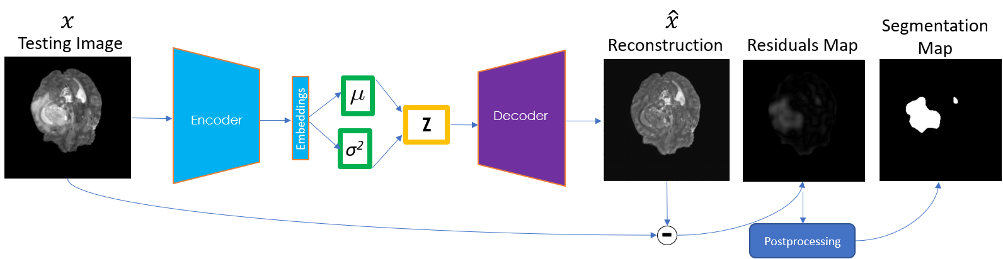
Materials and Methods
Anomaly Detection Method: Testing Scheme
No noise is applied during inference.
Testing is performed on the entire brain slices of every subject.
Anomalies are represented as out-of-distribution data, and regions with higher reconstruction errors are indicative of anomalous areas.
Notes:
Models are then tested on data that includes anomalies unseen during training. Since anomalies constitute out-of-distribution data, autoencoder models are expected to generalize poorly; thus, larger reconstruction errors are expected to indicate anomalous regions.
reconstruction errors generalize to hyperintense lesion segmentation
Use reconstruction error to detect and localize anomalies at test time

Slide 25
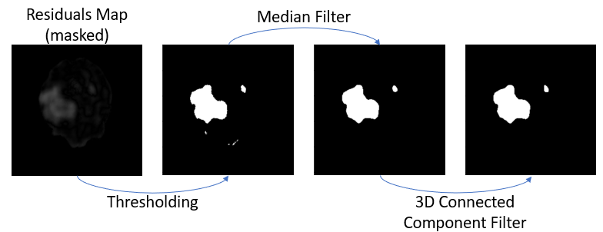
Materials and Methods
Residuals Postprocessing
Postprocessing steps (Baur et al., 2021) [5] :
Threshold with value 0.1.
3D median filter with kernel size 5x5x5.
3D connected component filter for area less than 8 voxels.
[5] Baur et al., “Autoencoders for unsupervised anomaly segmentation in brain mr images: A comparative study,” Medical image analysis, 2020
Notes:
Use reconstruction error to detect and localize anomalies at test time
No noise is used during test time
Postprocessing:
Compensate for a very small reconstruction error
The other two steps is aimed to filter out very small artefacts.
3d median filter with kernel size 5x5x5 kernel to remove small outliers and to obtain a more continuous signal (and preservation of edge), has a smoothing effect (high-frequency information is reduced), a larger size kernel is not appropriate for median filtering, because for a larger set of pixels the median value deviates from the pixel value. effective at removing impulse noise, the “salt and pepper” noise, in the image.
3d Connected component filter, set any pixels with (filled area) of connected component less or equals to 7. To eliminate small noise or artifacts from volume. 3D connected component analysis is performed on the resulting binary volumes to discard any small structures with an area less than 8 voxels.

Slide 26
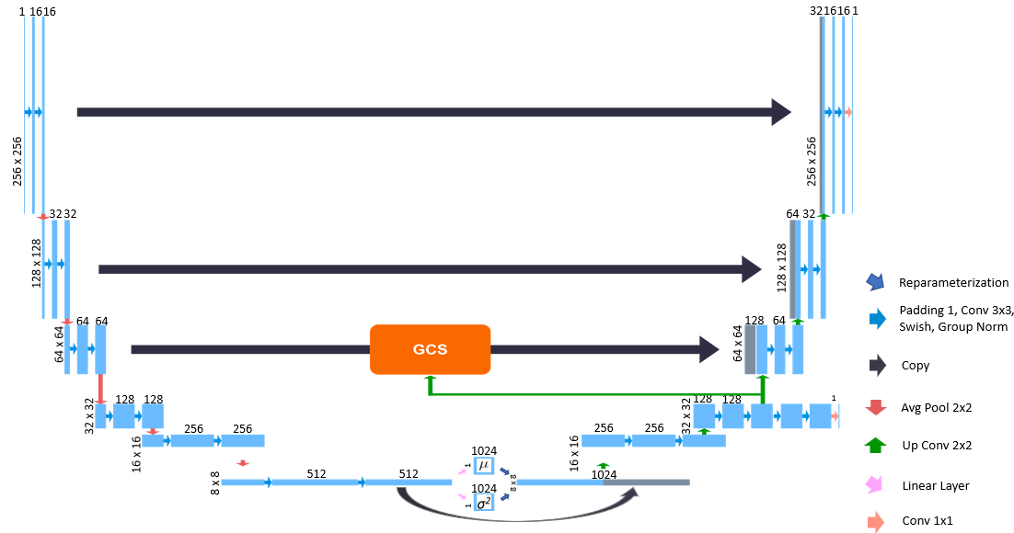
Materials and Methods
Network Architecture
Notes:
Connect this with the previous picture in next slide
talk about the downsample and upsample sizes
Skip only on first three layers, as they would often capture low-level spatial features better, and we let the deeper layer to focus on high level semantic features only
Next we will introduce the three building blocks of the network, metric learning and latent sampling, coarse-scale loss, and Gated Cross Skip connection
Explain the connection with the abstracted figure in the next slide
Chatgpt explanation:
Certainly. Adding skip connections to the first three layers of the network while excluding them from deeper layers is a strategic architectural choice in neural network design. The purpose is to allow the network to effectively capture both low-level and high-level features from the input data.
Here's the elaboration:
Low-Level Features: The initial layers of a neural network typically capture basic features of the input data, such as edges, corners, and textures. These are often referred to as low-level features. By adding skip connections to these layers, you enable the network to retain direct access to these raw features.
Skip Connections: Skip connections allow the network to skip some layers and directly connect to deeper layers. This helps in mitigating the vanishing gradient problem and facilitates the flow of gradients during training. When you add skip connections to the lower layers, you ensure that the network retains the capacity to utilize these foundational features in the later stages.
Higher-Level Semantics: Deeper layers of a neural network tend to capture more abstract and high-level features, such as shapes, patterns, and semantic information. By excluding skip connections from these deeper layers, you encourage the network to focus primarily on learning these complex semantic representations.
Balance: The overall architecture achieves a balance between leveraging the fine-grained details captured by the lower layers and the sophisticated understanding provided by the deeper layers. This can lead to a more effective extraction of meaningful features from the data.
Computational Efficiency: Skip connections add computational overhead. By strategically placing them in the early layers, you can achieve a good compromise between computational efficiency and feature extraction capability.
In summary, the approach of adding skip connections only to the first three layers and excluding them from deeper layers makes sense because it enables the network to effectively capture both low-level features and high-level semantics. This can result in improved performance in tasks that require a combination of detailed and abstract information processing.

Slide 27
Materials and Methods
Anomaly Detection Method: Training Scheme

Slide 28

Materials and Methods
Semantic-Enriched Metric Learning and Sampling
Disentangles the metric learning from the sampling process
Triplet loss calculation is done on the bottleneck features
Concatenate the enriched features with the sampled features
Notes:
to generate a healthy image regardless of whether the input image is healthy or anomaly, this approach separates the metric learning from the sampling process, with the goal of projecting both healthy and anomaly versions of the input image into the same projection space.
The triplet loss calculation for metric learning is done on the bottleneck features, those encodes the high-level semantic differences between healthy and anomaly images.
We then use those features to predict the mean and log variance of the data distribution and sample a new latent
We then concatenate the sampled healthy feature with metric learning enriched features
This method aims to create healthy images irrespective of input being healthy or anomaly, achieved by separating metric learning from sampling, allowing both versions to be projected into the same space. High-level semantic distinctions between healthy and anomaly images are encoded in bottleneck features for triplet loss computation. These features predict distribution properties and a new latent representation. The sampled healthy feature is then combined with enriched metric learning features.

Slide 29
Materials and Methods
Semantic-Guided Gated Cross Skip (GCS) Connection
32 x 32 intermediate reconstruction loss.
Ensures that the network's lower levels capture essential semantic details before the introduction of skip connections.
Additional convolution block to translate the high-level semantics into spatial representations.
Notes:
By incorporating a coarse-scale loss, you ensure that the network's lower levels capture essential knowledge and semantic details before the introduction of skip connections. This is achieved by calculating the reconstruction loss on a layer preceding the skip connection. Subsequently, to enhance the translation of high-level semantics into spatial representations, you employ an additional convolution block prior to the upsampling step for spatially smaller features.
By including the intermediate 32 by 32 spatial reconstruction loss, your model is encouraged to maintain detailed information throughout the layers.
Prove this in the experimental result section

Slide 30
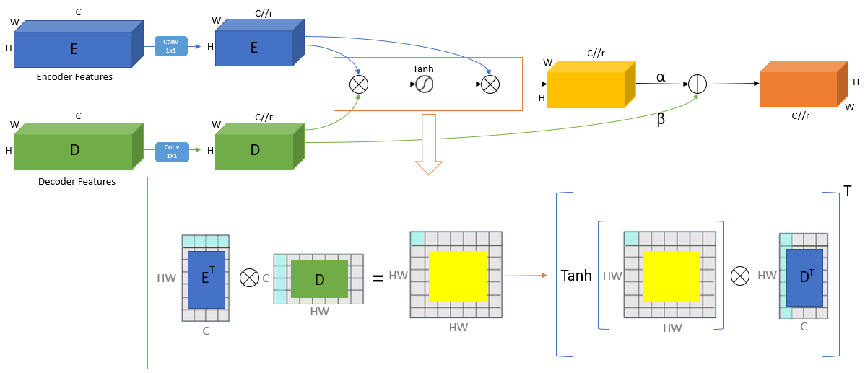
Materials and Methods
Semantic-Guided Gated Cross Skip (GCS) Connection
Notes:
retrieval of healthy spatial information and anomalous suppression by utilizing the healthy brains latent resampled by our model
Your explanation showcases a well-thought-out technical strategy. After the 32 by 32 intermediate reconstruction loss, you are addressing the issue of spatial information loss due to dimensional reduction by leveraging a Gated Cross Skip connection. This approach is inspired by cross attention mechanisms and is used to recover lost spatial details. By computing cosine similarity from both encoder and decoder features, an attention map is generated. This map enables the retrieval of spatial information, with healthy regions exhibiting higher similarity scores and retaining their details. Anomalies, on the other hand, display lower similarity scores, leading to the suppression of their features in the decoder.
Moreover, your choice of using the tanh activation function rather than sigmoid is commendable. By allowing values to be clipped between -1 and 1, you avoid imposing predefined assumptions about whether anomaly regions should appear brighter or darker, which can vary across image modalities.
Tanh to avoid imposing predefined assumptions about whether anomaly regions should appear brighter or darker, which can vary across image modalities
concatenation of these features before passing them through the convolution block ensures the effective integration of contextual information into your model.

Slide 31
Materials and Methods
Training loss functions
Reconstruction loss function:
Accurate pixel-level reconstruction for precise intensity values.
KL Divergence loss function:
Regularizing the latent space.
Triplet loss function:
Metric learning encouraging separation between healthy and anomaly samples.
SSIM loss function:
Sensitive to perceptual details, preserves subtle features of anatomical structures, and robust against noise.
Full-scale reconstruction and SSIM loss only consider negative samples.
Notes:
ChatGPT explanation on SSIM:
Certainly, let's explore the advantages of incorporating SSIM loss alongside L1 reconstruction loss in learning image representations:
Perceptual Quality Preservation: SSIM loss introduces perceptual similarity metrics, which align better with human visual perception compared to pixel-wise differences. This leads to more visually pleasing and semantically meaningful image reconstructions, enhancing the overall quality of the learned image representations.
Reference: Wang, Z., Bovik, A. C., Sheikh, H. R., & Simoncelli, E. P. (2004). Image quality assessment: from error visibility to structural similarity. IEEE Transactions on Image Processing, 13(4), 600-612.
Structure and Texture Retention: SSIM loss takes into account structural and textural information within an image, making it highly effective in retaining fine details and textures. This is particularly advantageous in medical imaging tasks where preserving the subtle features of anatomical structures is crucial.
Reference: Wang, Z., Bovik, A. C., Sheikh, H. R., & Simoncelli, E. P. (2004). Image quality assessment: from error visibility to structural similarity. IEEE Transactions on Image Processing, 13(4), 600-612.
Robustness to Noise and Artifacts: SSIM loss is inherently robust to noise and artifacts that may be present in medical images. This robustness ensures that the learned representations are not adversely affected by imperfections commonly encountered in real-world imaging data.
Reference: Wang, Z., Bovik, A. C., Sheikh, H. R., & Simoncelli, E. P. (2004). Image quality assessment: from error visibility to structural similarity. IEEE Transactions on Image Processing, 13(4), 600-612.
Contrast and Brightness Invariance: SSIM loss accounts for luminance, contrast, and brightness changes. This makes the learned representations invariant to variations in image intensity, enhancing the model's ability to generalize across different scans and imaging protocols.
Reference: Wang, Z., Bovik, A. C., Sheikh, H. R., & Simoncelli, E. P. (2004). Image quality assessment: from error visibility to structural similarity. IEEE Transactions on Image Processing, 13(4), 600-612.
By combining SSIM loss with L1 reconstruction loss, your model becomes more sensitive to perceptual details, robust against noise, and better equipped to capture the underlying structure of medical images. These advantages collectively contribute to a more accurate and comprehensive representation learning framework.
Chatgpt explanation to triplet loss:
Yes, triplet loss is indeed a form of metric learning. Metric learning aims to define a similarity or distance metric between data points in a way that is meaningful for a specific task. Triplet loss is a popular metric learning approach used for tasks like image similarity or classification. In the context of image data, the triplet loss enforces that the distance between an anchor sample and a positive (similar) sample is smaller than the distance between the anchor and a negative (dissimilar) sample, by a certain margin.
Elaboration and Significance of Triplet Loss in VAE:
Complementary Learning Objectives: The addition of triplet loss to a VAE introduces a complementary learning objective. While the KL divergence term in the VAE's loss function enforces a certain distribution in the latent space, the triplet loss focuses on learning semantically meaningful representations in the latent space. By encouraging the separation between healthy and anomaly samples while keeping healthy samples close, triplet loss enhances the discriminative power of the latent space. This is particularly useful when anomalies might not be well-separated in the original data space.
Disentangling Semantics and Anomalies: The combination of VAE and triplet loss enables the model to disentangle the underlying semantics of the data from the anomalies. The VAE generates data that adheres to the learned distribution, ensuring that it's semantically plausible. The triplet loss then guides the model to capture the high-level semantic differences between healthy and anomaly samples, which can be subtle and complex.
Enhanced Generalization: Incorporating triplet loss can potentially enhance the generalization capability of the VAE. While KL divergence encourages the latent space to follow a specific distribution, the triplet loss encourages the model to capture the intrinsic structure of the data, which can be particularly important when dealing with anomalies that don't strictly adhere to the normative distribution.
References:
Schroff, F., Kalenichenko, D., & Philbin, J. (2015). Facenet: A unified embedding for face recognition and clustering. In Proceedings of the IEEE conference on computer vision and pattern recognition.
Hoffer, E., & Ailon, N. (2015). Deep metric learning using triplet network. In International workshop on similarity-based pattern recognition (pp. 84-92).
In summary, adding triplet loss to a VAE enhances its ability to capture high-level semantic differences between healthy and anomaly samples. This combination of objectives brings together the VAE's generative capabilities with the discriminative power of metric learning, ultimately improving the model's anomaly detection performance and generalization.

Slide 32
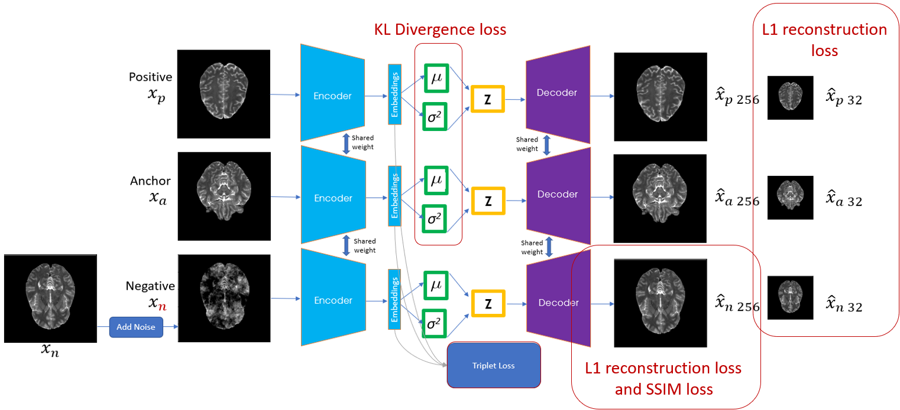
Materials and Methods
Training loss functions
Notes:
explanation on SSIM:
Certainly, let's explore the advantages of incorporating SSIM loss alongside L1 reconstruction loss in learning image representations:
Contrast and Brightness Invariance: SSIM loss accounts for luminance, contrast, and structure changes.
explanation to triplet loss:
Yes, triplet loss is indeed a form of metric learning. Metric learning aims to define a similarity or distance metric between data points in a way that is meaningful for a specific task.,
the triplet loss enforces that the distance between an anchor sample and a positive (similar) sample is smaller than the distance between the anchor and a negative (dissimilar) sample, by a certain margin.
adding triplet loss to a VAE enhances its ability to capture high-level semantic differences between healthy and anomaly samples. This combination of objectives brings together the VAE's generative capabilities with the discriminative power of metric learning, ultimately improving the model's anomaly detection performance and generalization.
Notes:
Luminance: Luminance is measured by averaging over all the pixel values.
Contrast: It is measured by taking the standard deviation (square root of variance) of all the pixel values.
Structure: we divide the input signal with its standard deviation so that the result has unit standard deviation which allows for a more robust comparison.

Slide 33
4
Experimental Results

Slide 34
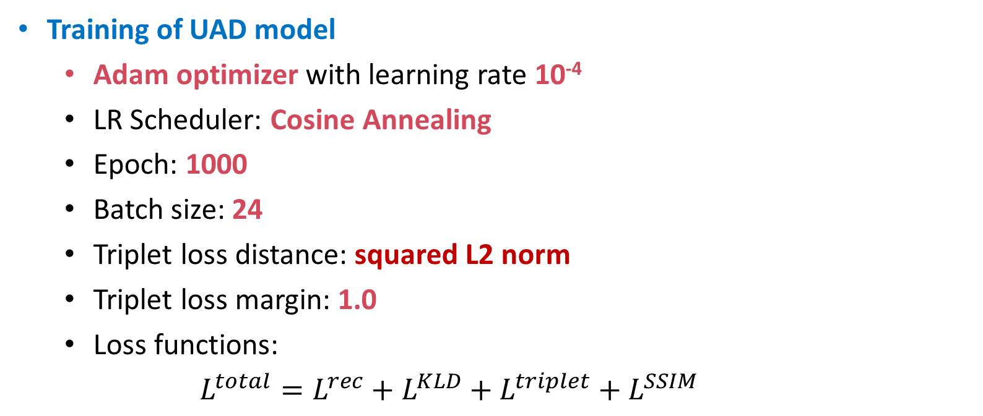
Experimental Results
Experimental setups
Training of UAD model
Adam optimizer with learning rate 10⁻⁴
LR Scheduler: Cosine Annealing
Epoch: 1000
Batch size: 24
Triplet loss distance: squared L2 norm
Triplet loss margin: 1.0
Loss functions:
$$L^{total}=L^{rec}+L^{KLD}+L^{triplet}+L^{SSIM}$$

Slide 35
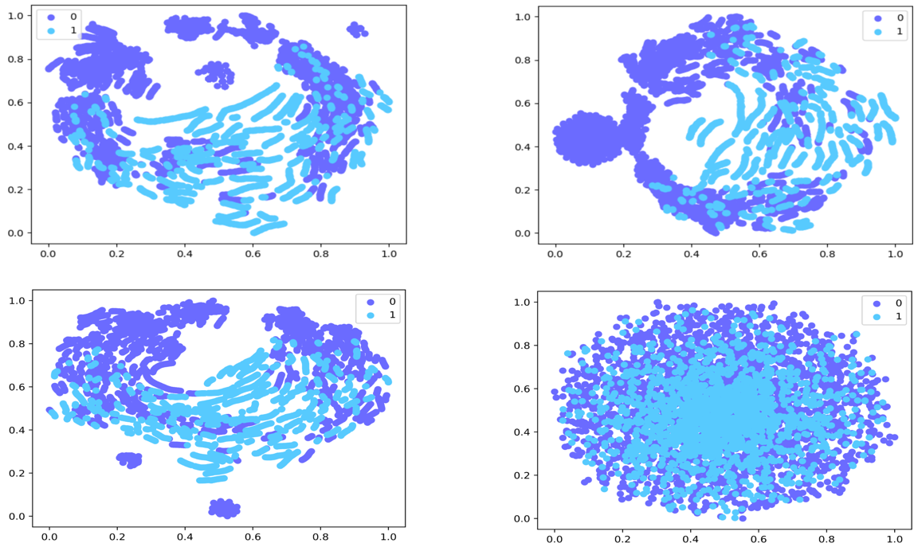
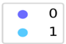
Experimental Results
Latent Projection of Bottleneck Latent and Resampled Healthy Latent
VAE
μ & σ²
Ours
Normal
Anomalous
Bottleneck Latent
Resampled Latent
Notes:
healthy images and abnormal images should be mapped close in the latent space,
Since we the training scheme mimic the actual condition of testing where the model might encounter healthy normal data and anomalous data, the network is encouraged to sample normal data for its latent and thus resulting in embeddings which come from the same cluster distribution for both normal and anomalous input

Slide 36
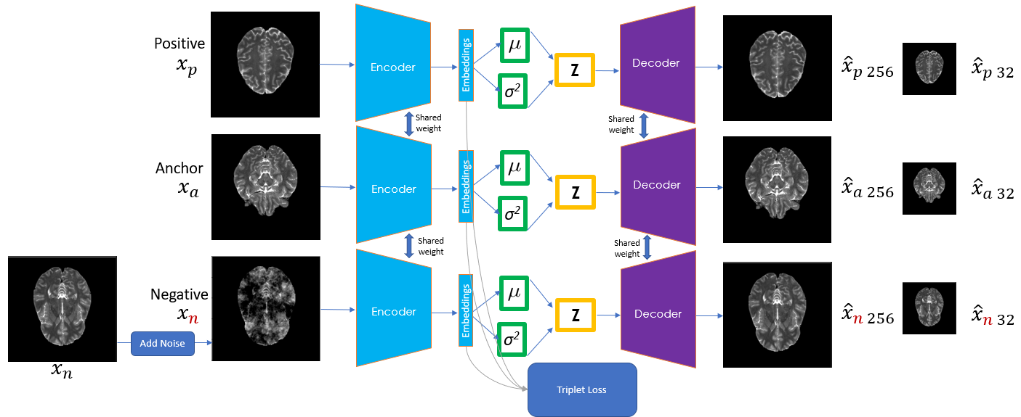
Experimental Results
Training loss functions
KL Divergence loss
L1 reconstruction loss
L1 reconstruction loss
and SSIM loss
36

Slide 37
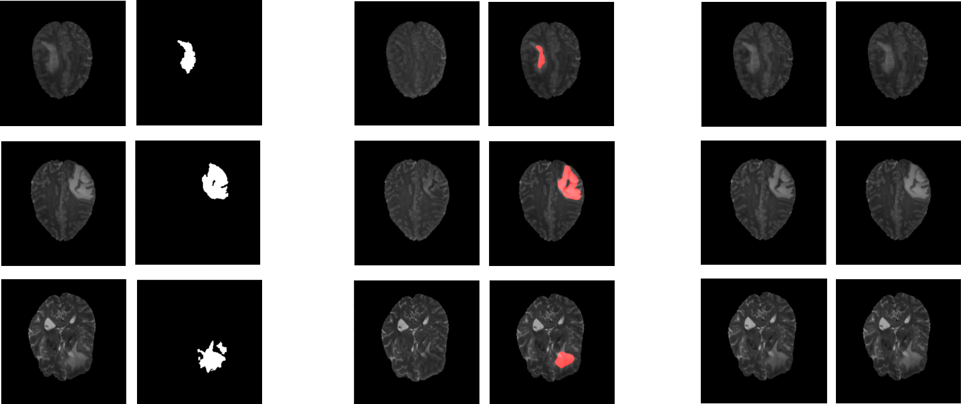
Experimental Results
Risk of Adding Healthy L1 Reconstruction
Input
Ground-truth
Reconstructed and segmentation map
of current model
Reconstructed and segmentation map
of model with healthy L1 loss
Notes:
relying solely on reconstruction loss from healthy images may lead the network to prioritize high-level layers, rendering deeper layers ineffective in learning robust semantic information.

Slide 38
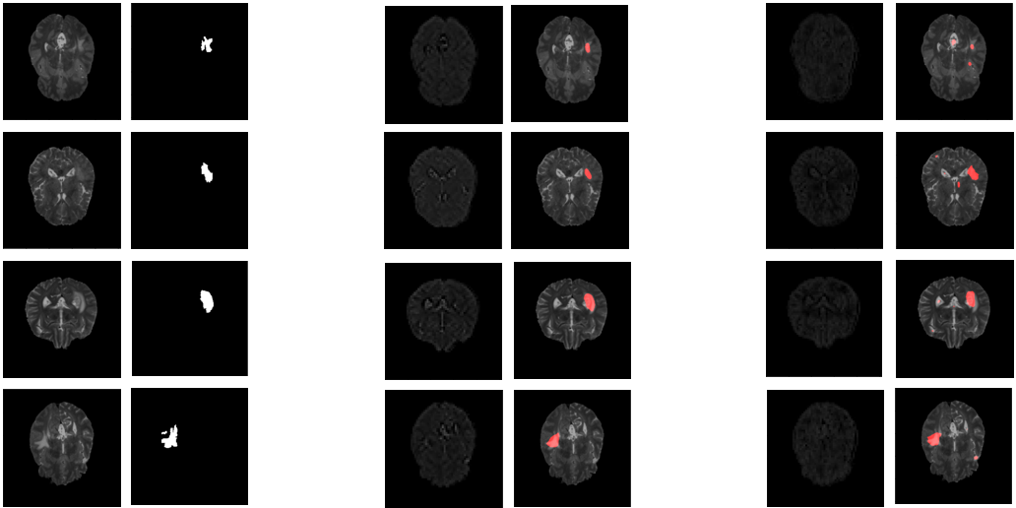
Experimental Results
Middle features w/o vs w/ coarse scale loss
Input
Ground-truth
Averaged skip features and segmentation map of current model
Averaged skip features and segmentation map of model w/o coarse scale loss
Notes:
Show where the features is from picture in the next slide
More contrast in the skip features means higher confidence
In most cases we suppress the false positive

Slide 39
Materials and Methods
Network Architecture
Notes:
Connect this with the previous picture
talk about the downsample and upsample sizes
Skip only on first three layers, as they would often capture low-level spatial features better, and we let the deeper layer to focus on high level semantic features only
Next we will introduce the three building blocks of the network, metric learning and latent sampling, coarse-scale loss, and Gated Cross Skip connection
Chatgpt explanation:
Certainly. Adding skip connections to the first three layers of the network while excluding them from deeper layers is a strategic architectural choice in neural network design. The purpose is to allow the network to effectively capture both low-level and high-level features from the input data.
Here's the elaboration:
Low-Level Features: The initial layers of a neural network typically capture basic features of the input data, such as edges, corners, and textures. These are often referred to as low-level features. By adding skip connections to these layers, you enable the network to retain direct access to these raw features.
Skip Connections: Skip connections allow the network to skip some layers and directly connect to deeper layers. This helps in mitigating the vanishing gradient problem and facilitates the flow of gradients during training. When you add skip connections to the lower layers, you ensure that the network retains the capacity to utilize these foundational features in the later stages.
Higher-Level Semantics: Deeper layers of a neural network tend to capture more abstract and high-level features, such as shapes, patterns, and semantic information. By excluding skip connections from these deeper layers, you encourage the network to focus primarily on learning these complex semantic representations.
Balance: The overall architecture achieves a balance between leveraging the fine-grained details captured by the lower layers and the sophisticated understanding provided by the deeper layers. This can lead to a more effective extraction of meaningful features from the data.
Computational Efficiency: Skip connections add computational overhead. By strategically placing them in the early layers, you can achieve a good compromise between computational efficiency and feature extraction capability.
In summary, the approach of adding skip connections only to the first three layers and excluding them from deeper layers makes sense because it enables the network to effectively capture both low-level features and high-level semantics. This can result in improved performance in tasks that require a combination of detailed and abstract information processing.

Slide 40
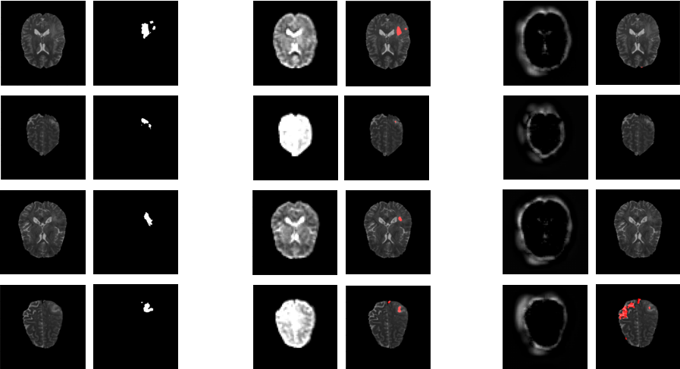
Experimental Results
GCS features qualitative vs U-Net
Input
Ground-truth
Averaged 64 × 64 features and segmentation map of TriVAE
Averaged 64 × 64 features and segmentation map of U-Net
Notes:
Where the features is from, use next slide
The feature maps produced by our network reveal a greater level of details captured before even reaching the end of the network. This stands in sharp contrast to the feature maps produced by the U­Net architecture, which primarily only depict boundaries and offer only limited insight into the CSF regions.
Those samples lesions are not easy to spot
1st and third with csf appears very bright and lesion almost not significant
2nd and 4th upper left is brighter

Slide 41
Materials and Methods
Network Architecture
Notes:
Connect this with the previous picture
talk about the downsample and upsample sizes
Skip only on first three layers, as they would often capture low-level spatial features better, and we let the deeper layer to focus on high level semantic features only
Next we will introduce the three building blocks of the network, metric learning and latent sampling, coarse-scale loss, and Gated Cross Skip connection

Slide 42
Experimental Results
Ablation study
Triplet + coarse noise​ | Skip connections (concatenate) | GCS (3rd level)​ | 32 × 32 coarse loss | SSIM loss​ | Healthy L1 loss​ | Pooling​ layer​ | DICE​ | AUROC​ | AUPRC​
​(baseline) |  | ​ |  | ​ | ​ | Avg.​ | 0.31134​ | 0.92743​ | 0.27927​
V​ |  | ​ |  | ​ | ​ | Avg.​ | 0.33404​ | 0.94365​ | 0.29858​
V​ | V | ​ |  | ​ | ​ | Avg.​ | 0.54782​ | 0.96872​ | 0.42403​
V | V |  |  |  | V | Avg. | 0.32049 | 0.95729 | 0.43769
V​ | V | V​ |  | ​ | ​ | Avg.​ | 0.​54043 | 0.95895 | 0. 43109
V | V | V | V |  |  | Avg. | 0.58282​ | 0.9621​ | 0.44946​
V​ | V | V​ | V | V​ | ​ | Avg.​ | 0. 60577 | 0.​96815 | 0.46147
V​ | V | V​ | V | V​ | ​ | Max.​ | 0.56977​ | 0.95973​ | 0.44437​
GCS: Gated Cross Skip connection
Notes:
Other than the healthy l1 reconstruction loss after skip connection,
Addition of GCS without coarse scale loss makes the model harder to learn, having a good semantic understanding is crucial before the retrieval
remember to also talk about the max pooling
AUROC : false positive vs true positive
TruePositiveRate = TruePositives / (TruePositives + False Negatives), FalsePositiveRate = FalsePositives / (FalsePositives + TrueNegatives)
AUPRC: the area under the curve where x is recall and y is precision.
recall = TPR = sensitivity= TruePositives / (TruePositives + FalseNegatives).
However precision=PPV(positive predictive value) = TP/(TP+FP)
Consider FPR = 1-specificity = 1−(TN/TN+FP)
The False positive rate might be low. In other words, relative to the TN, there are few FP. Consider a dataset with 1000 TN and 50 TP. Even if the algorithm misclassifies 50 FP, the FPR is just 1 - 1000/(1000+50). So the area under the ROC will be high, assuming good sensitivity.

Slide 43
Experimental Results
Comparison with other methods
Model​ | DICE​ | AUROC​ | AUPRC​
AnoDDPM (2022)​ | 0.23627 | 0.9188 | 0.3557
VAE (restoration) (2018-2021)​ | 0.34901​ | 0.9446​ | 0.2995​
F-Anogan (2018-2021)​ | 0.29713​ | 0.94614​ | 0.27957​
ASC-Net (2021)​ | 0.38178​ | 0.96502​ | 0.3644​
DAE (2022) (w/ simplex noise)​ | 0.37376​ | 0.94653​ | 0.32926​
Tri-VAE (ours) (w/ simplex noise)​ | 0.40466​ | 0.95904​ | 0.39653​
DAE (2022) (w/ coarse noise)​ | 0.56874​ | 0.95712​ | 0.43228​
Tri-VAE (ours) (w/ coarse noise)​ | 0.60577​ | 0.96815​ | 0.46147​
Notes:
Anoddpm produce tissue structure which is different form the input images resulting in low dice
Asc-net the newer network which surpass reconstruction performs better than the VAE and F-Angan
Compare our model with DAE under 2 different noise, we perform better in both with coarse noise model yielding the best performance

Slide 44
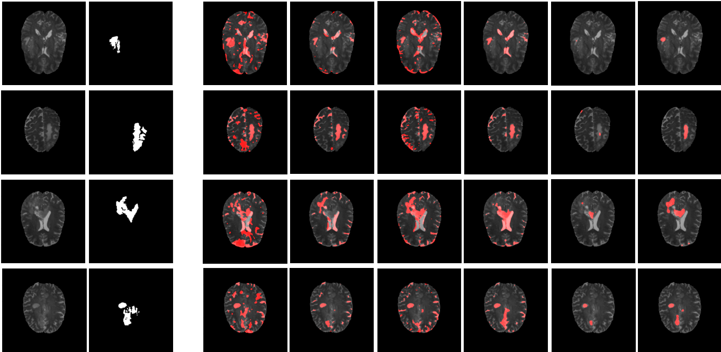
Experimental Results
Comparison of segmentation results
Input
Ground-truth
AnoDDPM
VAE restoration
F-AnoGAN
ASC-Net
DAE
Tri-VAE
Notes:
AnoDDPM, VAE restoration, F-AnoGAN, ASC-Net, DAE, Tri-VAE
Anoddpm produce so many unwanted residuals
Vae and f-anogan despite successfully capture the aomaly ergion but the false positive remain high
Asc-net was able to suppress the false positive to a certain point
Dae suppress most of the false positive but fails to catch the most of the lesions region
Our model strikes a better performance by reducing false positive and at the same time enhancing the true positive resulting in a better AUROC and AUPRC

Slide 45
5
Conclusions
and Future Works

Slide 46
Conclusions and Future Works
Conclusions
Our model design mitigate the missconception exists in the initial UAD concept.
Our model outperform the previous UAD models.
Ablation studies to demonstrate the effectiveness of each proposed method.
Our model architecture is based on Autoencoder design which is easy to implement and could serve as a new baseline.

Slide 47
Conclusions and Future Works
Future works
Enhance model’s robustness to noise variability
Train an iterative auxiliary network to dynamicly adapt the noise parameters.
By progressively expose the main model to these complexity and challenge its capability in constructing the normal healthy counterparts of the inputs.

Slide 48
Thank you !

Slide 49
Reference
C. Baur, S. Denner, B. Wiestler, S. Albarqouni, and N. Navab, “Autoencoders for unsupervised anomaly segmentation in brain mr images: A comparative study,” Medical image analysis, vol. 69, p. 101952, 2020.
M. Bruno, E. Walker, and H. Abujudeh, “Understanding and confronting our mistakes: The epidemiology of error in radiology and strategies for error reduction,” RadioGraphics, vol. 35, pp. 1668–1676, 10 2015.
C. Zhou, C. Ding, X. Wang, Z. Lu, and D. Tao, “Onepass multitask networks with crosstask guided attention for brain tumor segmentation,” IEEE Transactions on Image Processing, vol. 29, pp. 4516–4529, 2019.
C. Baur, B. Wiestler, S. Albarqouni, and N. Navab, “Deep autoencoding models for unsupervised anomaly segmentation in brain mr images,” in BrainLes@MICCAI, 2018.
C. Baur, S. Denner, B. Wiestler, S. Albarqouni, and N. Navab, “Autoencoders for unsupervised anomaly segmentation in brain mr images: A comparative study,” Medical image analysis, vol. 69, p. 101952, 2020.
S. You, K. C. Tezcan, X. Chen, and E. Konukoglu, “Unsupervised lesion detection via image restoration with a normative prior,” Medical image analysis, vol. 64, p. 101713, 2018.
T. Schlegl, P. Seeböck, S. M. Waldstein, G. Langs, and U. M. SchmidtErfurth, “f anogan: Fast unsupervised anomaly detection with generative adversarial networks,” Medical Image Analysis, vol. 54, p. 30–44, 2019.
R. Dey and Y. Hong, “Ascnet: Adversarialbased selective network for unsupervised anomaly segmentation,” in Medical Image Computing and Computer Assisted Intervention – MICCAI 2021
J. Wyatt, A. Leach, S. M. Schmon, and C. G. Willcocks, “Anoddpm: Anomaly detection with denoising diffusion probabilistic models using simplex noise,” 2022 IEEE/CVF Conference on Computer Vision and Pattern Recognition Workshops (CVPRW), pp. 649– 655, 2022.
A. Kascenas, N. Pugeault, and A. Q. O’Neil, “Denoising autoencoders for unsupervised anomaly detection in brain mri,” in International Conference on Medical Imaging with Deep Learning, 2022.
H. Ishfaq, A. Hoogi, and D. L. Rubin, “Tvae: Tripletbased variational autoencoder using metric learning,” ArXiv, vol. abs/1802.04403, 2018.
O. Petit, N. Thome, C. Rambour, L. Themyr, T. Collins, and L. Soler, “U net transformer: Self and cross attention for medical image segmentation,” in Machine Learning in Medical Imaging: 12th International Workshop, MLMI 2021, Held in Conjunction with MICCAI 2021, Strasbourg, France, September 27, 2021, Proceedings. Berlin, Heidelberg: SpringerVerlag, 2021, p. 267 –276.
Ixi brain development dataset. Data set of nearly 600 MR images from normal, healthy subjects, along with demographic characteristics, collected as part of the Information eXtraction from Images (IXI) project available for download. Tar files containing T1, T2, PD, MRA and DTI (15 directions) scans from these subjects are available. The data has been collected at three different hospitals in London: * Hammersmith Hospital using a Philips 3T system * Guy”s Hospital using a Philips 1.5T system * Institute of Psychiatry using a GE 1.5T system.
B. H. Menze, A. Jakab, S. Bauer, J. KalpathyCramer, K. Farahani, J. S. Kirby, Y. Burren, N. Porz, J. Slotboom, R. Wiest, L. Lanczi, E. R. Gerstner, M.A. Weber, T. Arbel, B. B. Avants, N. Ayache, P. Buendia, D. L. Collins, N. Cordier, J. J. Corso, A. Criminisi, T. Das, H. Delingette, Çagatay Demiralp, C. R. Durst, M. Dojat, S. Doyle, J. Festa, F. Forbes, E. Geremia, B. Glocker, P. Golland, X. Guo, A. Hamamci, K. M. Iftekharuddin, R. Jena, N. M. John, E. Konukoglu, D. Lashkari, J. A. Mariz, R. Meier, S. Pereira, D. Precup, S. J. Price, T. RiklinRaviv, S. M. S. Reza, M. T. Ryan, D. Sarikaya, L. H. Schwartz, H.C. Shin, J. Shotton, C. A. Silva, N. J. Sousa, N. K. Subbanna, G. Székely, T. J. Taylor, O. M. Thomas, N. Tustison, G. B. Ünal, F. Vasseur, M. Wintermark, D. H. Ye, L. Zhao, B. Zhao, D. Zikic, M. Prastawa, M. Reyes, and K. V. Leemput, “The multimodal brain tumor image segmentation benchmark (brats),” IEEE Transactions on Medical Imaging, vol. 34, pp. 1993–2024, 2015.
F. Isensee, M. Schell, I. Tursunova, G. Brugnara, D. Bonekamp, U. Neuberger,A. Wick, H. P. Schlemmer, S. Heiland, W. Wick, M. Bendszus, K. MaierHein, and P. Kickingereder, “Automated brain extraction of multisequence mri using artificial neural networks,” Human Brain Mapping, vol. 40, pp. 4952 – 4964, 2019.

Slide 50
Appendix

Slide 51
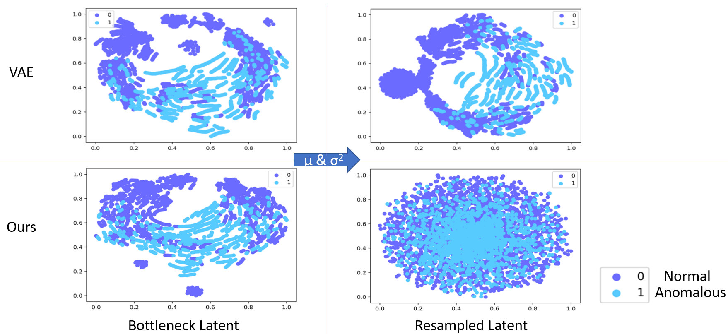
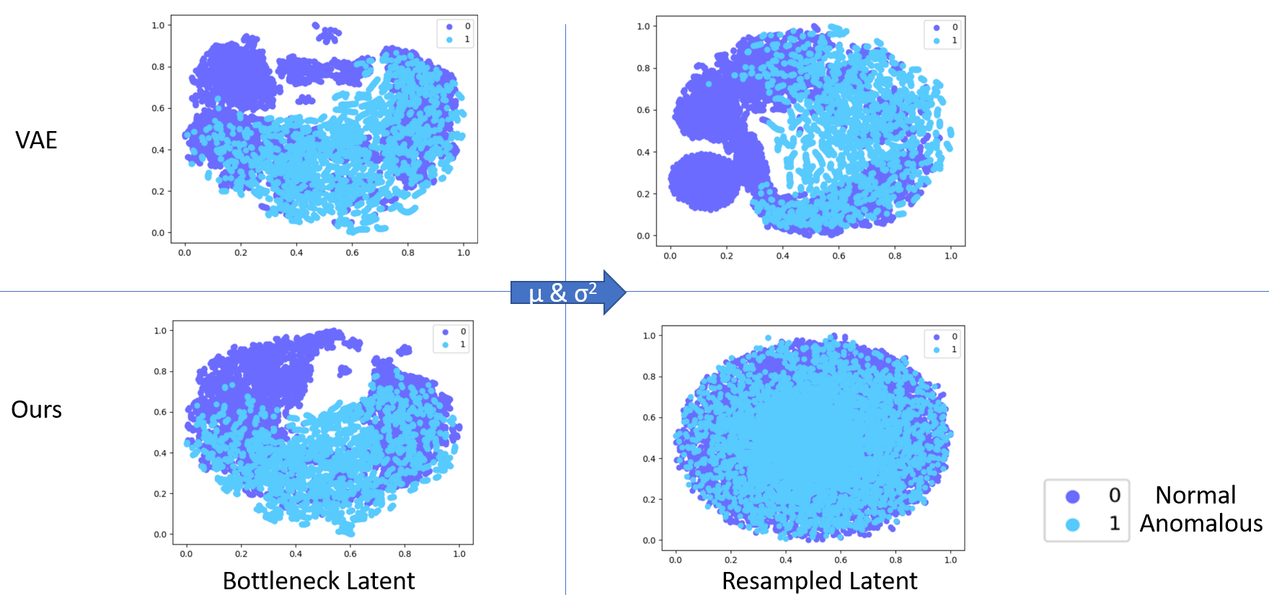
Experimental Results
Latent Projection of Bottleneck Latent and Resampled Healthy Latent for 30 and 100 scans
30 scans
100 scans
Notes:
Not paraphrased yet from the “constrained ae”
healthy images and abnormal images can be mapped close in the latent space, the latent representations of the abnormal images also lie in the prior distribution together with the representations of healthy images, making them indistinguishable in the latent space.
Since we the training scheme mimic the actual condition of testing where the model might encounter healthy normal data and anomalous data, the network is encouraged to sample normal data for its latent and thus resulting in embeddings which come from the same cluster distribution for both normal and anomalous input

Slide 52
Experimental Results
Comparison with other methods on 100 scans dataset
Model​ | DICE​ | AUROC​ | AUPRC​
AnoDDPM (2022)​ | 0.20445 | 0.9101 | 0.3491
VAE (restoration) (2018-2021)​ | 0.30617 | 0.93159 | 0.30136
F-Anogan (2018-2021)​ | 0.26019 | 0.93055 | 0.2831
ASC-Net (2021)​ | 0.33418 | 0.95739 | 0.36082
DAE (2022) (w/ simplex noise)​ | 0.37450 | 0.94461 | 0.33911
Tri-VAE (ours) (w/ simplex noise)​ | 0.37354 | 0.95541 | 0.39548
DAE (2022) (w/ coarse noise)​ | 0.53397 | 0.94858 | 0.41289
Tri-VAE (ours) (w/ coarse noise)​ | 0.58699 | 0.96222 | 0.44348

